Slide 1


Guidelines for Programmatic Management of
Drug Resistant Tuberculosis in India 2021
National TB Elimination Programme
Central TB Division, Ministry of Health & Family Welfare
Government of India, New Delhi

Slide 2
Chapter 4:
Treatment of DR-TB

Slide 3
Learning objectives
In this chapter, we will learn about:
Goals of TB treatment, grouping of drugs, health education and counselling.
Treatment of shorter/longer oral MDR/RR-TB regimen as well as rifampicin-susceptible and Isoniazid-resistant TB (including poly DR-TB) covering.
  Pre-treatment evaluation
  Technical and operational aspects of treatment
  Follow-up monitoring
  Management of DR-TB in children
  Management of special situations and comorbid conditions
Prevention and management of adverse drug events.
Treatment outcomes.
Implementation considerations and flow of patients along DR-TB care cascade

Slide 4
Definitions
Extent or severity of disease. In patients older than 18 years, this is usually defined by the presence of cavities or bilateral disease on chest radiography or smear positivity. In children under 18 years, severe disease is usually defined by the presence of cavities or bilateral disease on chest radiography or extra-pulmonary forms of disease other than lymphadenopathy (peripheral nodes or isolated mediastinal mass without compression). In children, the occurrence of advanced malnutrition (defined by syndrome or by metrics) or advanced immunosuppression or positive tuberculosis (TB) bacteriology (smear, NAAT, culture) may also be considered when determining disease severity.
Serious adverse events. SAEs are those adverse events (AEs) classified as Grade 3 (severe), Grade 4 (life-threatening or disabling) or Grade 5 (death related to AE), or which led to the drug being stopped permanently. SAEs are otherwise often defined as AEs that either lead to death or a life-threatening experience; to initial or prolonged hospitalization; to persistent or significant disability; or to a congenital anomaly. The management of SAEs may require termination of the drug suspected of having caused the event.
People who use drugs. PWUD are those who engage in the harmful or hazardous use of psychoactive substances, which could have a negative impact on the user’s health, social life, resources and legal situation.
Underweight. In adults and adolescents, underweight usually refers to a body mass index <18.5 kg/m2 and in children < 10 years to a weight-for-age < –2 z-scores.

Slide 5
Goal of TB treatment
Render patient non-infectious, break the chain of transmission and decrease pool of infection
Decrease TB deaths and related comorbidity by ensuring relapse free cure
Minimize & prevent development and amplification of drug resistance

Slide 6
Grouping* of anti-TB drugs and other consideration
Groups & steps | Medicine | Abbreviation
Group A Include all three medicines | Levofloxacin or Moxifloxacin | Lfx Mfx
 | Bedaquiline | Bdq
 | Linezolid | Lzd
Group B Add one or both medicines | Clofazimine | Cfz
 | Cycloserine or Terizidone | Cs Trd
Group C Add to complete the regimen and when medicines from Group A and B cannot be used | Ethambutol | E
 | Delamanid | Dlm
 | Pyrazinamide | Z
 | Imipenem-cilastatin or Meropenem | Ipm-Cln Mpm
 | Amikacin (OR Streptomycin) | Am (S)
 | Ethionamide or Prothionamide | Eto Pto
 | p-aminosalicylic acid | PAS
Drugs not included in Groups A–C
Kanamycin and Capreomycin:
  Associated with poorer outcomes
  No longer recommended for use in MDR-TB regimens.
Gatifloxacin
  Non availability of quality-assured preparations due to concern about dysglycaemias.
Thioacetazone
  Not available in a quality-assured formulation.
Clavulanic acid
  Only a companion agent to the carbapenems (Imp-Cln and Mpm)
  Not to be counted as an effective TB agent
* Reference: WHO Consolidated Guidelines for TB module 4: Treatment of DR-TB 2020
Annexure 11: evidences on efficacy and safety of the second-line anti-TB drugs

Slide 7
Newer drugs
Bedaquiline
Delamanid
Diarylquinoline that specifically targets mycobacterial ATP synthase, an enzyme which supplies energy to M.tb
Strong bactericidal and sterilizing activities
High volume of distribution, with extensive tissue distribution, highly bound to plasma proteins and is hepatically metabolized.
The drug has an extended half-life, present in the plasma up to 5.5 months post stopping Bdq.
Significantly improves time to culture conversion in MDR-TB patients
First approved drug in the class of nitro-dihydro-imidazo-oxazoles for the treatment of MDR-TB.
Bactericidal drug with 36 hours of half-life
Act with two different mechanisms
  It blocks the synthesis of mycolic acids
  Poison the bacilli with nitric oxide
As per WHO recommendation, the risk-benefit considerations for the use of Bdq in patients aged 6–17 years and Dlm in patients aged 3–5 years are similar to those considered for adults.

Slide 8
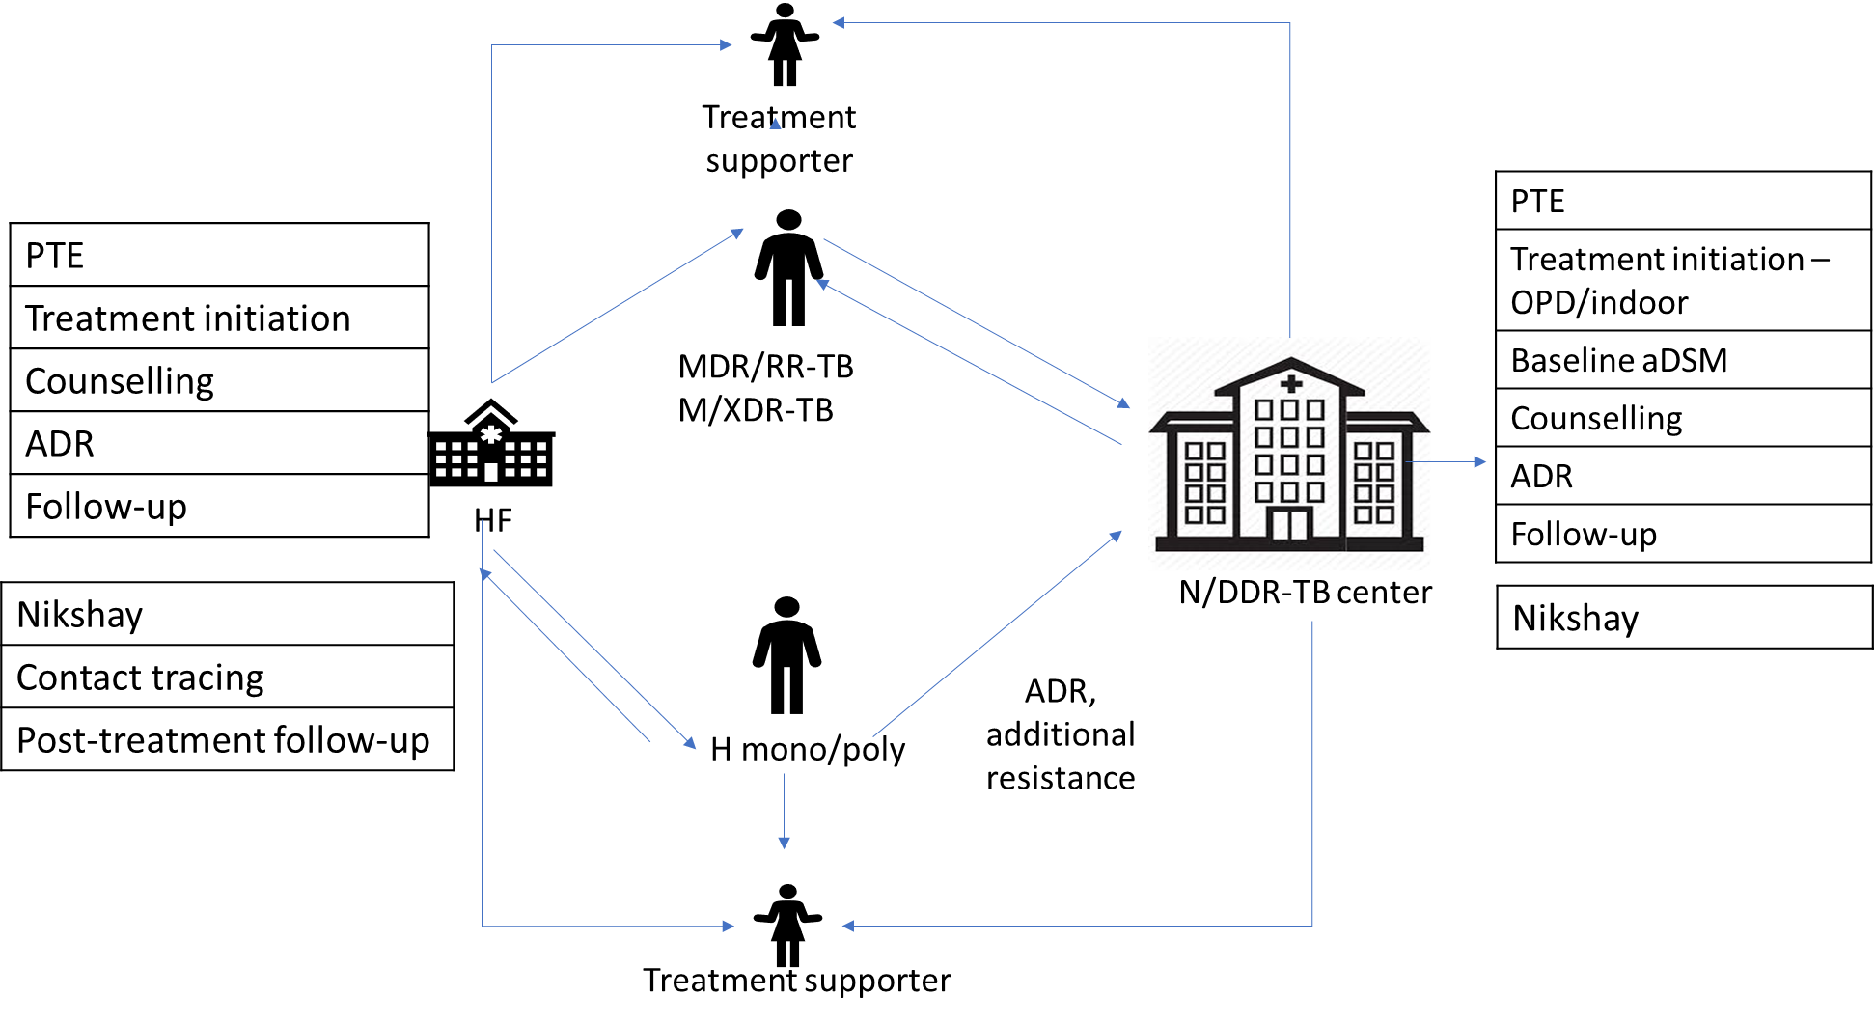
Patient flow in the DR-TB treatment care cascade
Notes:
elaborates the processes for the prompt initiation of treatment in DR-TB patients. Patients with H mono/poly DR-TB may be initiated on treatment at any of the health facilities (HF) after the pre-treatment evaluation. Patients with MDR/RR-TB or XDR-TB need to be referred for necessary pre-treatment evaluations, basis which their treatment is initiated at the N/DDRTBC. Counselling of the patient and his/her family is done at home or over phone by the health workers and doctor at the health facility. An appropriate treatment supporter needs to be identified in consultation with the patient and trained to monitor treatment adherence, maintain records, identify and report minor side effects of DR-TB patients. In case of severe ADRs, the patients will be referred to N/DDR-TBC. The contacts of the MDR/RR-TB patient with FQ susceptible, upon ruling out active TB are initiated on preventive treatment as per the guidelines. HFs are responsible to update the information of DR-TB patients in Nikshay on real-time basis. All the process as mentioned in the care cascade needs to be monitored by the TB unit (MO-TU) and senior DR-TB TB-HIV supervisor.

Slide 9
Treatment care cascade
Patient should be traced immediately with help of Community Health Officer (CHO) of Health & Wellness Centers (HWC), health facility doctor and its staff (including TB health visitor [TBHV] and Senior Treatment Supervisor [STS])
H mono/poly DR-TB: initiated on treatment at any of the health facility (HF) after PTE
M/XDR-TB: initiated on treatment at the N/DDR-TBC after pre-treatment evaluation
Counselling of patient & family at home or over phone and link to appropriate treatment supporter
Contacts of MDR/RR-TB patient with FQ susceptible: initiated on TPT after ruling out active TB disease
HFs are responsible to update the information of DR-TB patients in Nikshay
Care cascade needs to be monitored by TB Unit (MO-TU) and Senior DR-TB TB-HIV supervisor

Slide 10
Health education & counselling
Health education and counselling to the DR-TB patients and their family members about disease, mechanism of transmission and necessity of taking regular and adequate treatment, nutrition etc. (DR-TB Counselling tool-detailed later)
Counselling should start at the initial point of contact as soon as the diagnosis is established and continued during all the visit of patient at HF or health worker to patient’s home or Nikshay Sampark
Although, NTEP provides a counsellor at every NDR-TBC for this purpose, all counsellors and health-care workers in the health system need to know the key points of counselling to DR-TB patients
Confidentiality and informed decision making process is paramount

Slide 11
Pre-treatment counselling
Duly informed decision regarding use of all anti-TB drugs and regimen
Written consent NOT needed for any treatment regimen under NTEP
Training of counsellor
Counsellor register: for recording the information (Annexure 13)
Pre-treatment counseling
Information on lab result
Importance of early initiation and adherence to treatment
Nature and duration of treatment
Possible change in the treatment
Care and support services under NTEP
Reassurance to the family against stigma
Infection control precaution
Family planning
Contact investigation of family and TPT

Slide 12
Counselling during treatment
Treatment duration of any DR-TB regimen is long enough for the patient which needs multiple sessions of counselling, preferably more frequently in the initial phase of treatment.
Explore and address past and present difficulties by the patients on treatment
Maintain confidentiality
Help to generate supportive environment in the family
Help the patient to understand importance of regular treatment as well as consequences of deviation from the treatment
Counsellor register: for recording the information (Annexure 13)

Slide 13
DR-TB counselling tool
Greet and Introduce
Build rapport in order to establish an effective relationship
Greet the patient and introduce yourself; establish boundaries by describing your role clearly
Education
Assess and provide correct and updated information
Provide basic information on TB and discuss about symptoms of TB
Cough hygiene
Cough hygiene and AIC at home is very important
Discuss about contagious nature of TB
Collect basic demographic details
Differentiate between DS-TB and DR-TB
Explain about DR-TB diagnosis
Explain about DR-TB treatment regimen, duration, side effect and adherence
Assess and arrange support system available for adherence
Correct cough hygiene and safe disposal of sputum
Use of mask / handkerchief
Wet mopping is advisable
Stigma and discrimination
Free diagnosis and free treatment under NTEP
Assure that all the information shared or discussed will be kept confidential
Notes:
AIC air born infection control

Slide 14
DR-TB counselling tool
Nutrition and diet
Nikshay Poshan Yojana
Nutritious and high protein diet is important
Assess food habits
Inform about social welfare scheme
Link the patient with Nikshay Poshan Yojana and other social welfare scheme
Advise based on socio-cultural and economic background
Consider underlying comorbidities while advise on diet (e.g. Diabetes, Hypertension)
Other aspects
Important other aspects of counselling
De-addiction counselling
Addressing mental health
Family caregiver counselling
Addressing stigma and discrimination
Sexual and reproductive health

Slide 15
Key messages for TB counselling… 1
TB is an airborne infection, caused by the germ Mycobacterium tuberculosis.
A person contracts TB infection from an open case of TB (usually a sputum smear positive pulmonary TB case). However, infection with TB does not necessarily mean that the infected person would develop TB disease. An infected person develops disease when his/her immunity declines.
Prolonged cough, for 2 weeks or more, fever, loss of weight or night sweat can be TB disease and therefore it is essential to consult a doctor and get examined to rule out TB.
Sputum microscopy, molecular testing (NAAT test) and treatment for TB (DS-TB or DR-TB) are available free of cost at all the peripheral health institutes under National Tuberculosis Elimination Programme.
Diagnosis and treatment services under NTEP are also available to patients seeking care in the private sector.

Slide 16
Key messages for TB counselling… 2
Cure from TB can only be ensured by taking complete and regular treatment. Anti-TB drugs are provided in patient-wise drug boxes, which ensure that the full course of treatment is available.
Treatment is provided at a place near the patient’s home which is convenient and acceptable to the patient and accountable to the system.
Irregular medication or inappropriate regimen are the leading causes of drug-resistant tuberculosis.
New drugs (bedaquiline, delamanid and pretomanid) available under NTEP are safe and effective.
It is important to maintain cough hygiene and take nutritional food as per custom of the patient.
Patient will be linked with Nikshay Poshan Yojana under which TB patient will entitle to direct transfer of benefit of Rs. 500/- per month during entire treatment duration.

Slide 17
Key messages for TB counselling… 3
Contacts of TB patient should also be assessed for sign and symptoms of tuberculosis and after ruling out TB in contacts, TB preventive therapy (TPT) should be offered.
In event of adverse drug reaction, patient is advised to seek medical consultation.
Patient should follow family planning practice during the entire treatment duration.
Pregnant woman with DR-TB and the family should be given
  thorough understanding regarding the need for MTP if gestation is < 20 weeks (24 weeks when the bill will be passed),
  risk of delaying treatment,
  potential effect of newer drugs on the fetus and mother if MTP not opted, and
  the need for more intense maternal-fetal-neonatal follow- up.
  The regimen should be individualized in expert consultation, if pregnant woman with tuberculosis is not willing for MTP or gestation is beyond 20 weeks.

Slide 18
Treatment algorithm of MDR/RR-TB
Rifampicin resistance detected⁴
SECOND SPECIMEN TESTED AT C&DST LAB
FL-LPA ⁵ + SL-LPA ⁶ + LC DST⁷ – Z, Bdq⁸, Cfz⁸, Mfx, Lzd, Dlm⁸
After completing PTE, check on Nikshay or with C&DST lab, if LPA results are available
YES
NO
YES
Other exclusion criteria⁹ for shorter regimen
No additional resistance detected⁴ or
H resistance detected⁴ with Kat G or Inh A mutation (not both) & FQ resistance not detected⁴
H resistance detected⁴ with both Kat G and Inh A mutation or
FQ resistance detected⁴
ABSENT
PRESENT
Shorter oral Bedaquiline-containing MDR/RR-TB regimen¹⁰
Longer oral M/XDR-TB regimen¹¹
Additional resistance or intolerance or non-availability of any drug in use or emergence of exclusion criteria or return after LTFU or failure
Longer Oral M/XDR-TB regimen, modified if needed as per replacement table
Notes:
FL-LPA : FIRST LINE LINE PROBE ESSAY
SL-LPA: SECOND LINE LINE PROBE ESSAY
LC DST : LIQUID CULTURE AND DRUG SENSITITY TEST

Slide 19
Footnotes of Treatment algorithm for MDR/RR-TB… 1
As per mutation pattern, includes resistance inferred
Discordance in RR results between NAAT & FL-LPA to be resolved with a repeat NAAT at C&DST lab and microbiologists will provide the final decision. Inh A mutation associated with Eto resistance. Use other exclusion criteria to decide regimen if FL-LPA is done on culture isolates for patients with smear negative specimen.
To assess Lfx, Mfx and Am resistance
Start treatment based on LPA results & modify based on LC-DST results later.
Whenever DST is available
Other exclusion criteria for shorter regimen include
  History of exposure for > 1 month to BDQ, Lfx, Eto or Cfz, if result for DST (BDQ, FQ, Inh A mutation, Cfz & Z) is not available
  Intolerance to any drug in the shorter MDR TB regimen or risk of toxicity from a drug in the shorter regimen(e.g. drug–drug interactions)

Slide 20
Footnotes of Treatment algorithm for MDR/RR-TB… 1
  Extensive TB disease – presence of bilateral cavitary disease or extensive parenchymal damage on chest radiography. In children aged under 15 years, presence of cavities or bilateral disease on chest radiography.
  Severe EP-TB disease - presence of miliary TB or TB meningitis or CNS TB. In children aged under 15 years, extrapulmonary forms of disease other than lymphadenopathy (peripheral nodes or isolated mediastinal mass without compression)
  Pregnant and lactating women
  Children below 5 years
This portion applies as states move to shorter oral Bedaquiline-containing MDR/RR-TB regimen under guidance of NTEP.
Patients who were initiated on Longer oral regimen based on h/o exposure for > 1 month and in whom resistance is not detected to H or FQ may be switched to Shorter oral regimen based on the FL & SL LPA results, if the duration of Longer oral regimen drugs consumed is < 1 month.

Slide 21

Thank you
Go to for rapid assessment on Chapter 4
Back to 1st slide

