Slide 1
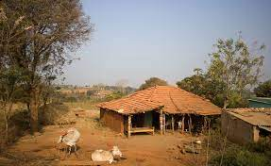
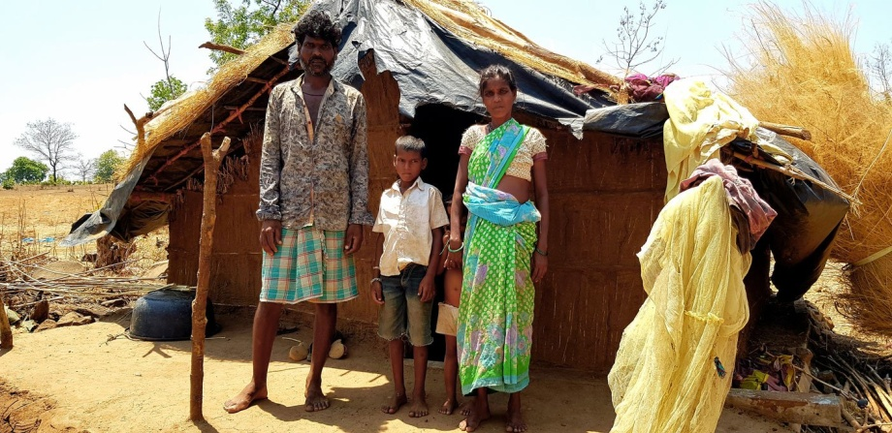
Welcome to
FAMILY ADOPTION PROGRAMME Department of Community Medicine,
GMC, Surat

Slide 2
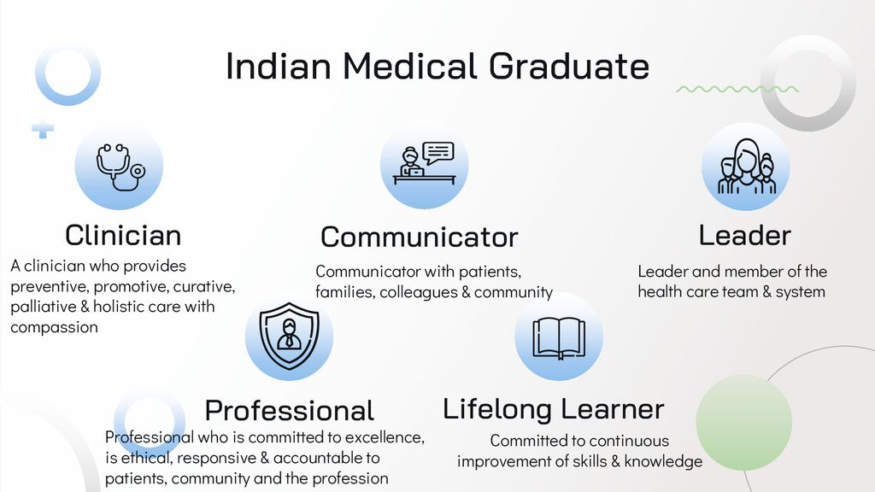
Roles of Indian Medical Graduate (IMG)

Slide 3

How to achieve these goals?
Competency Based Medical Education (CBME) is the umbrella
FAP is one of the tool to develop competencies and skills amongst IMG to discharge their duties.

Slide 4

Need of the FAP
In India, around 65.5 % of rural population(as per 2020 statistics)
Inequity in terms of
  Availability
  Accessibility
  Utilization of health cares services in Rural and Urban set up
Socio cultural, geographic and economic determinants played the role in inequity
Proactive involvement of future IMGs in understanding and resolving the barriers.

Slide 5

Aim of FAp
To provide experiential learning opportunity to future Indian Medical Graduates towards community based health care
Enhancing equity in community

Slide 6
Objective of the FAP:
1. Orientation of the learner towards primary health care
2.Create health related awareness within the community
3. Function as a first point of contact for any health issues within the community
4.Act as a conduit between the population and relevant health care facility.
5. Generate and analyze related data for improving health outcomes and Evidence based clinical practices.

Slide 7
Specifics of the Program:
As a part of curriculum and it starts from 1st professional year with competencies being spread in ascending manner for entire MBBS training program
Orientation should be started from Foundation Program.

Slide 8
The Future IMGs will be allotted families to adopt under mentorship of Faculty / SR / Resident doctors.
The IMGs will provide opportunities to communicate, to screen, to identify, facilitate to get diagnose and treatment / compliance for allotted family members.
The IMGs will provide opportunities to interact with field level workers (FLWs) like ASHA etc to understand service provision at village level.

Slide 9
The Future IMGs will meet the social influencers to understand socio cultural determinants.
If needed and feasible, camps for diagnosis and treatment will be organized in coordination with PHC.
In nut shell, IMGs proactive role in preventive, promotive, curative services for allotted family will be ascertained.

Slide 10
Competenencies (year wise)
1st Professional Year:
Learning communication skills and inspire confidence amongst families.
Understand the dynamics of rural set-up of that region.
Screening programs and education about ongoing government sponsored health related programs.
Learn to analyze the data collected from their families.
Identify diseases/ ill-health/ malnutrition of allotted families and try to improve the standards.

Slide 11
2nd Professional Year
Inspire active participation of community through families allotted.
Continue active involvement to become the first doctor /reference point of the family by continued active interaction.

Slide 12
3rd Professional Year
Analysis of their involvement and impact on existing socio-politico-economic dynamics in addition to improvement in health conditions.
Final visit in the last months in advance to examination schedule, to have last round of active interaction with family.

Slide 13
Professional year | Competency The student should be able to | objectives | Suggested Teaching Learning methods | Suggested Assessment methods | Teaching Hours
1st professional | Collect demographic profile of allotted families, take history and conduct clinical examination of all family members. | By the end of this visit,students should be able to compile the basic demographic profile of allocated family members. | Family survey,Community clinics,Multis-pecialty camps | Community case Presentation OSPE, Logbook, journal of visit | 6 hrs 2 visit
 | Organize health check –up and coordinate treatment of adopted family under overall guidance of mentor. | By the end of this visit,students should be able to report the basic health profile and treatment history öf allocated family members. | Reporting of follow up visits,PRA techniques (transact walk,group discussion )Community clinics | Community case Presentation OSPE, Logbook, journal of visit | 9 hrs 3 visit

Slide 14
Cont….
 | Maintain communicat-ion and follow up of remedial measures | By the end of this visit,students should be able to provide details of communication maintained with family members for follow-up of treatment and suggested remedial measures | Participation in and Process documentation of activities (NSS activities) along with reporting of photographic evidences | Community case Presentatio-n ,OSPE, Logbook based certificati-on of competen-cy, journal of visit | 6 hrs 2 visit
 | Take part in enviroment protection and sustenance activities | By the end of this visit,students should be able to report the activities undertaken for environment protection and sustenance like study of enviroment of families ,tree plantation/ herbal plantation activities conducted in the village |  | Logbook based certification of competen-cy, journal of visit | 2 visit 6 hrs

Slide 15
2nd Professional | Take history and conduct clinical examination of all family members | By the end of this visit,student should be able to update the medical history of family members and their vitals and anthropometry | Family survey , Community clinics | Communit-y case Presentation OSPE, Logbook, journal of visit | 6 hrs 2 visit
 | Organize health check –up and coordinate treatment of adopted family under overall guidance of mentor | By the end of this visit,students should be able to report the details of clinical examination like Hb%,blood group, urine routineand blood sugar along with treatment history of allocated family members | Community clinics, Multispecialt-y camps | Communit-y case Presentation OSPE, Logbook, journal of visit | 9 hrs

Slide 16
Cont….
 | Maintain communica-tion and follow up of remedial measures | By the end of this visit,students should be able to provide details of communication maintained with family members for follow-up of treatment, and suggested remedial measures along with details of vaccination drive | Reporting of follow up visits, PRA techniques (transact walk ,group discussion) community clinics, | Community case Presentatio-n ,OSPE, Logbook based certification of competen-cy, journal of visit | 9 hrs
 | Take part in enviroment protection and sustenance activities | By the end of this Visit students should be able to report the activities undertaken for environment protection and sustenance like study of environment of families tree plantation/ herba lplantation activities conducted in the village | Participation in and Process documentation of activities (NSS activities) along with reporting of photographic evidences | Logbook based certification of competen-cy, journal of visit | 6 hrs

Slide 17
3rd profession-al | Final counselling of the family members of alloted families and analyze the health trajectory of adopted family under overall guidance of mentor | By the end of this visit,student should be able to update the medical history of family members and their vitals and anthropometry | Family survey, Commun-ity clinics | Communit-y case Presentation OSPE, Logbook, journal of visit | 3 hrs
 |  | By the end of this visit,students should be able to report the details of clinical examination like Hb%,blood group, urine routine and blood sugar along with treatment history of allocated family members | Commun-ity clinics, Multispe-cialty camps | Communit-y case Presentation OSPE, Logbook, journal of visit | 4 hrs

Slide 18
Cont….
 |  | By the end of this visit,students should be able to provide details of communicatio-n maintained with family members for follow-up of treatment, and suggested remedial measures along with details of vaccination drive | Reporting of follow up visits,PRA, techniques(transact walk;group discussion)Com-munity clinics, | Community case Presentation ,OSPE, Logbook based certificati-on of competen-cy, journal of visit | 4 hrs

Slide 19
Cont….
 |  | By the end of this Visit students should be able to report the activities undertaken for environment protection and sustenance like study of environment of families tree plantation/ herbal plantation activities conducted in the village | Participation in and Process documentation of activities (NSS activities) alongwith reporting of photographic evidences - Small group discussion(report of the health trajectory of adopted family) | Logbook based certificati-on of competen-cy, journal of visit | 4 hrs 4 hrs +6 hrs in last visit
 |  | By the last visit, students should be able to analyze and report the health trajectory of adopted family along with remedial measures adopted at individual, family and community level |  |  | (Total 21 hrs, 5 visit)

Slide 20
Total | 1st prof 2nd prof 3rd prof | 9 visit 6 visit 5 visit 20 visit | 27 hrs 30 hrs 16 hrs+5 hrs In last visit 78 hrs

Slide 21

Expectations from IMGs
NOT A PICNIC.
ATTENDANCE COMPULSORY
Empathetic behaviour
Responsible mature behaviour
Learning and understanding attitute
Respecting their culture
Following mentor instructions

Slide 22

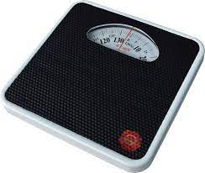
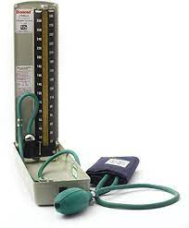
Logistics Provision
Transportation
Other logistics like required instruments will be provided by Dean Office and Department of CM.

Slide 23
Record maintaince
Log book is designed based on competencies

Slide 24
Assessment
Formative assessment – along with visits by mentor and during every internal exam due weightage is given to FAP performance by students.
Summative assessment – In University exam also, due weightage is given to FAP program in both theory and Practical exam.

Slide 25

Questions/ Queries/ Doubts ?

Slide 26
